Slide 1
CYSTIC DISEASE OF THE LIVER
Ahmet Bulent Dogrul,MD.
Hacettepe University
Notes:
DEAR PRESİDENT AND COLLAGUES
• I WİLL TRY TO TALK ABOUT SURGİCAL THERAPHY İNDİCATİONS İN TREATMENT OF CH DİSESASE

Slide 2
Hydatid disease is a parasitic infestation and a zoonotic disease. It is caused by the larval form of the tapeworm of the genus Echinococcus.
There are 4 known species of Echinococcus (E.granulosus, E.alveolaris, E.vogeli, E.oligarthrus), of which E.granulosus is the most common one.
The species Echinococcus granulosus is an intestinal parasite primarily found in dogs and the accidental ingestion of tapeworm eggs by humans results in cysts occuring in different tissues.
Humans are the intermediate hosts and infection occurs with the larval stages.

Slide 3
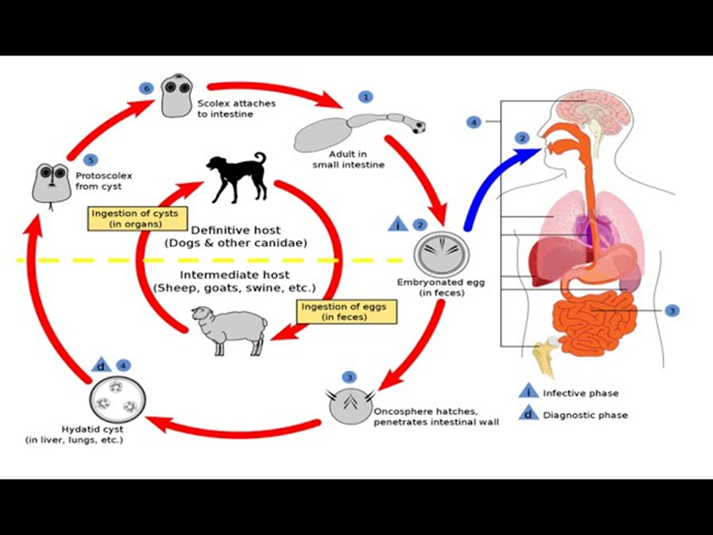
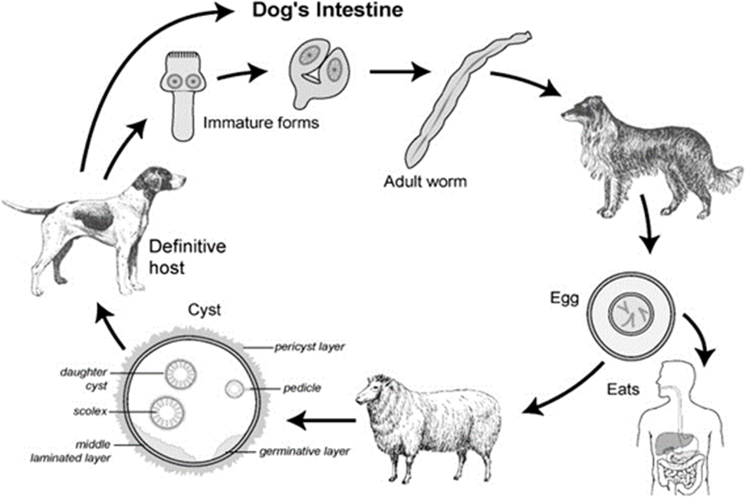
After ingestion of infected canine feces by the intermediate host (human), the embryos travel through intestinal mucosa to the liver via the portal venous system.
Most of them then are captured in the liver but some spread to other organs.
In these organs a transformation of the embryo to a cyst takes place and different layers form.

Slide 4
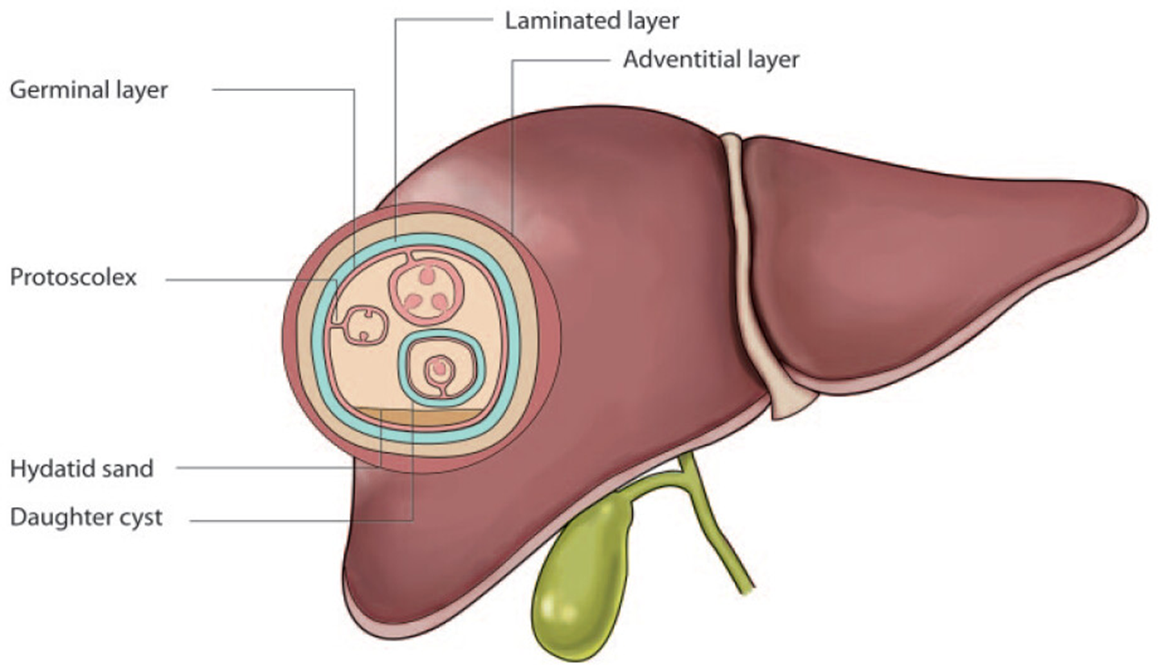
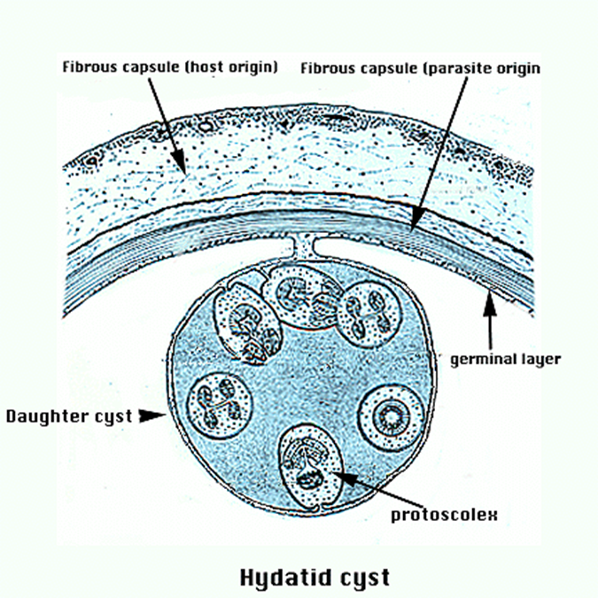
One of these layers is the germinative layer, which is the active part and generates the broad capsules, where scolices develop
Those scolices and daughter cysts float within the cyst in a highly antigenic fluid, the so called ‘’eau de roche’’.
Outside of the germinative layer there are 2 other layers found, of which the inner one is called the ‘’middle laminated layer’’ and the most outer one is the pericyst layer.
This fibrous but vascular layer represents the host’s reponse to the parasite and is neighboring the liver.

Slide 5
STAGING
Notes:
Satging is important because we decide to treatmnet type depending on the stgae of the disease. Currently we use WHO classification system depending on radiological imaging findings.

Slide 6
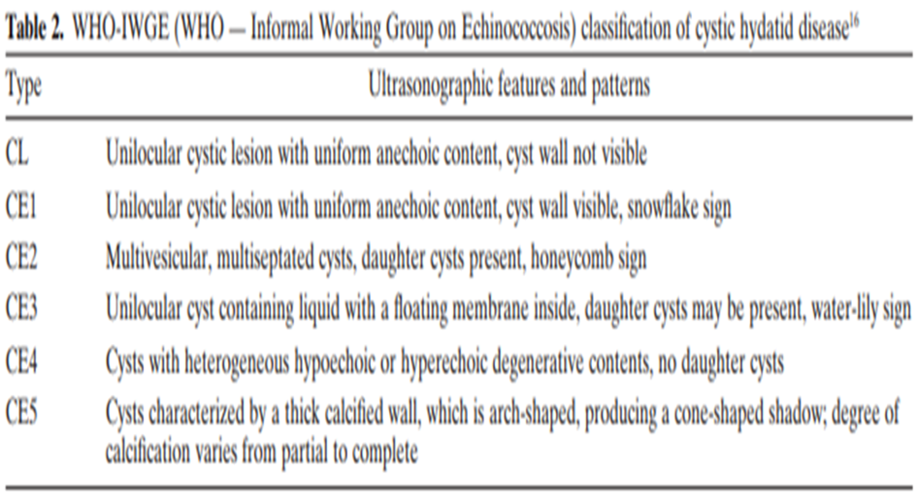
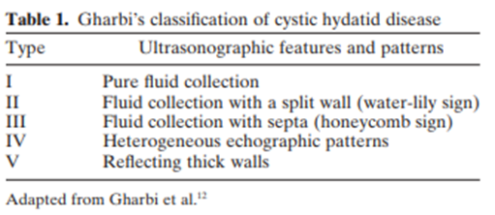

Slide 7
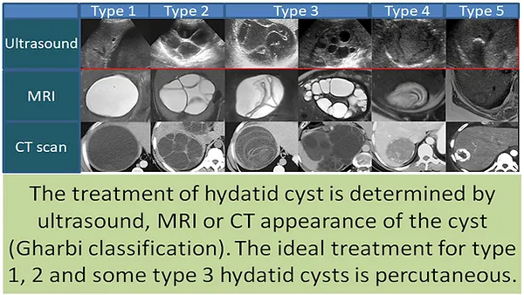

Slide 8
Hydatid disease of the liver is known from the time of Hippocrates, who refers the disesase of the liver full of water.
Since than, Cyst Hydadit disease is still an endemic disease in some regions of the world.
Fortunately, it has an umcomplicated course for most of patients.
Since percutaneous treatment of CH is feasible for most of the patients, surgeons face really complicated cases.

Slide 9
In more than 40% of the cases, the complications preceed the diagnosis.
Rupture, secondary infection and suppuration are the most common complications.

Slide 10
IDEAL TREATMENT
Eliminate the parasite and prevent recurrence of the disease
Minimum morbidity and mortality
Systemic chemotheraphy
Surgery
PAIR

Slide 11
SELECTION OF THE TREATMENT
Health status of the patient
Nature of the cyst
Presence of complications
Resources and expertise of the therapeutic team

Slide 12
PRINCIPLES OF SURGERY
Inactivation , removal and obliteration of the cavity
Spillage : immediate washout of the peritoneal cavity
Biliary fistula +/-: hypertonic saline
Partial cystectomy
Radical pericystectomy
Subadventitial pericystectomy
Hepatic resection
Omentoplasty
Marsipulaziation
Notes:
DURİNG SURGERY WE TOTALLY REMOVE CYST OR CONTENT OF THE CYST AFTER İNACTİVATİON AND OBLİTERATE THE CAVİTY MOSTLY BY OMENTOPEXY.

Slide 13
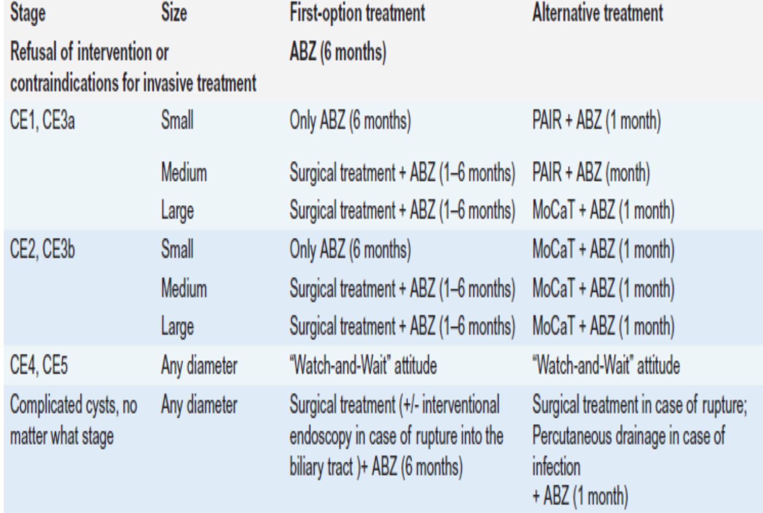

Slide 14
1980’s
Sayek et al. Arch Surg 1980,115,july

Slide 15
Notes:
42 years ago in our first reporrt from our center, surgery was the only treatment option for all form of the disease. And omentoplasty and cystectomy wwere the safest option according to our findings.

Slide 16

1994-1998
Notes:
AFTER THE İNTRODUCTİON OF PAİR, THE PERCENTAGE OF SURGİCAL PATİENTS DRAMATİCALLY DROP TO 37 PERCENT.

Slide 17
I-III
II
Notes:
AND AT THE END OF 10 YEARS, İN TYPE ( WHO-2), SURGERY WAS PERFORMED FOR ONLY NONDRAİNALE CYSTS FOR UNCOMPLİCATEDCYSTS.

Slide 18
Notes:
During the same period, 95 patients had been treated surgically in our center.

Slide 19
1992-2002
The American Journal of Surgery 2002,184;63-69
Notes:
the most common operative finding was biliary fistula,

Slide 20

2007-2016
Surgical treatment of cyst hydatid disease of the liver in the era of percutanous treatment
O. Cennet,M.B. Tirnaksiz,A.B. Dogrul,O. Abbasoglu
Conclusion: Although PAIR is the current treatment modality for some types of cyst hydatid disease of the liver, surgeons are still dealing with cyst hydatid disease of the liver but with complicated ones.
Notes:
Later we updated our findings inSURGİCALLY TREATED PATİENTS İN OUR CENTER.

Slide 21
2007-2016
88 patients
Age : 41 (17-74)
Female/male:3/2
Notes:
WE REVİEWED THE RESULTS OF 88 PATİENTS.

Slide 22
INDICATION FOR SURGERY
Biliary Fistula
Failed PAIR
Recurence after surgery
Others
Notes:
STİLL THE MOST COMMON İNDİCATİON FOR SURGERY WAS BİLİARY FİSTULA, AND FAİLED PAİR AND RECURRENCE AFTER SURGERY WERE OTHER NOT UNCOMMON İNDİCATİONS

Slide 23
TYPES OF SURGERY
Radical procedures
Radical procedures
Hemihepatectomy
Bisegmentectomy
Trisegmentectomy
Partial Cystectomy(+/- omentopexy)
89%

Slide 24
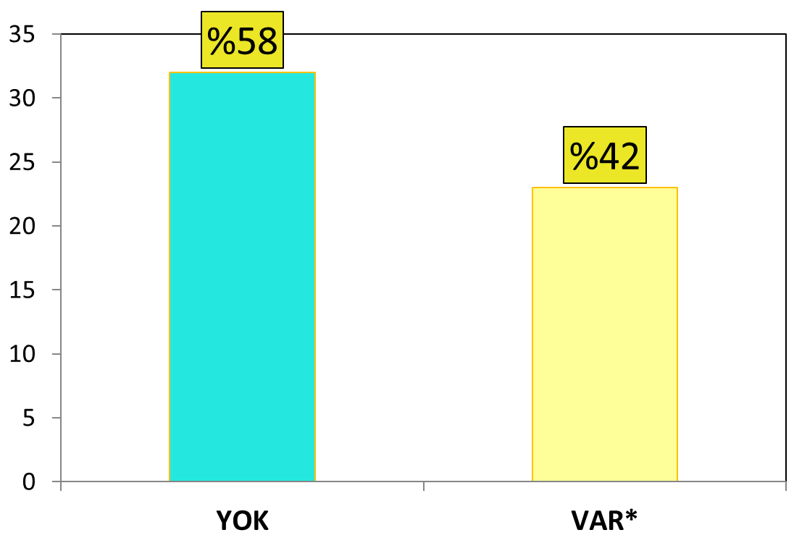
PREOPERATIVE INTERVENTIONS
NO YES
(*ERCP, Nasobiliary)
Notes:
And we have realized that 42%of patients required preop intervention in reoperative period.

Slide 25
ERCP AFTER SURGERY
Preop
ERCP+
Preop
ERCP –
Notes:
And in patients with preop ercp, only 3 % but without ercp 40 % needed ercp after the operation.

Slide 26
Journal of Medicine and Life Vol 11, Issue 3, 2018

Slide 28
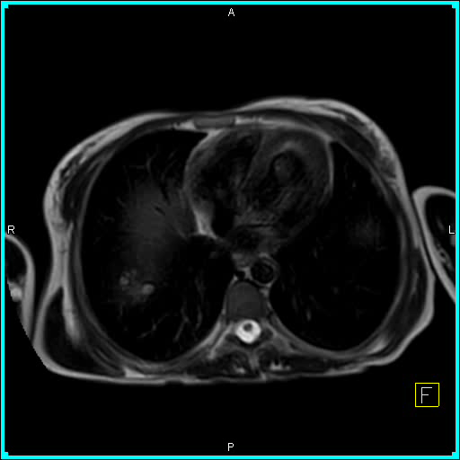
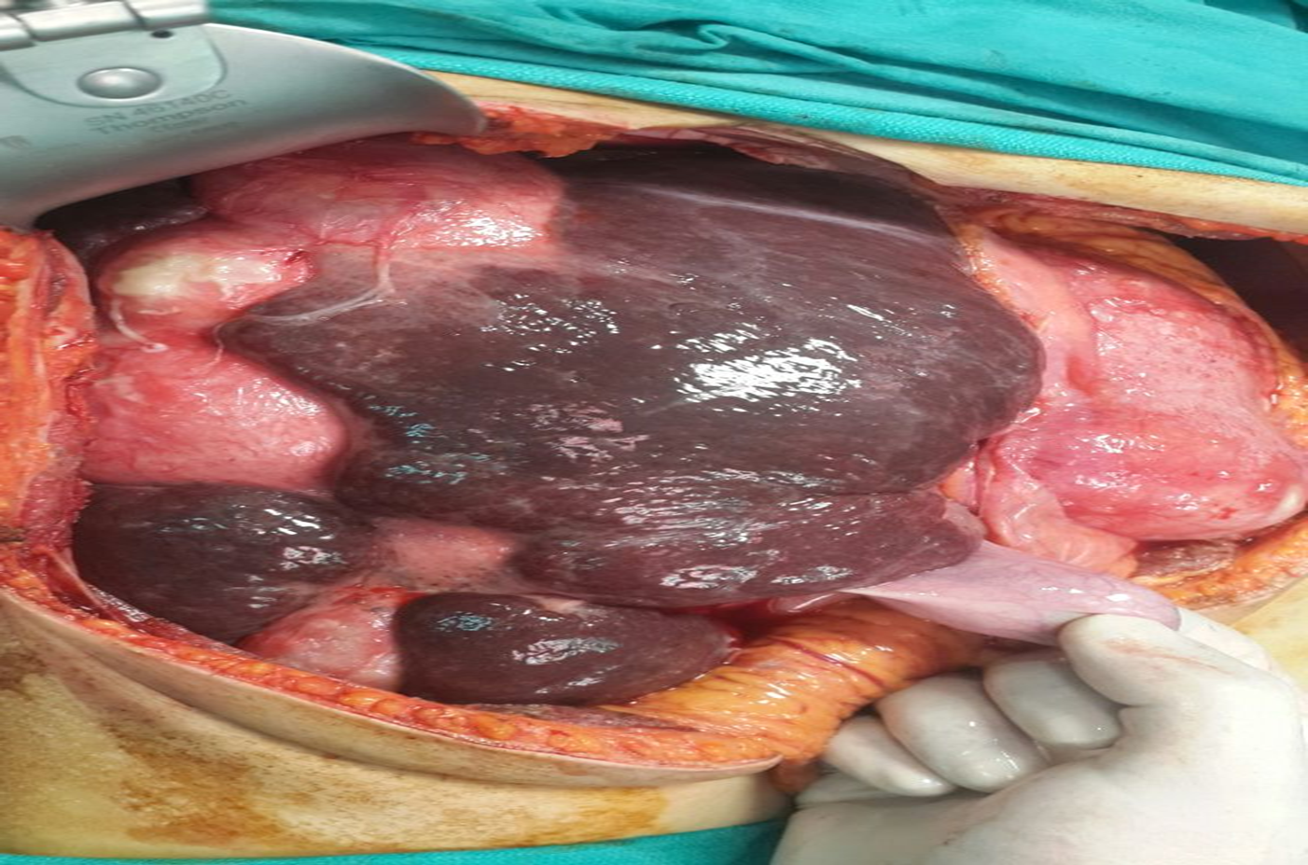
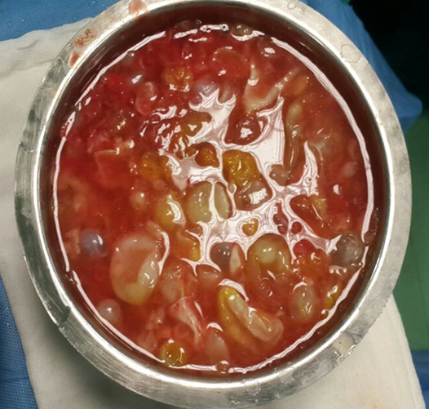
Notes:
gggggggggggggggggggg

Slide 29
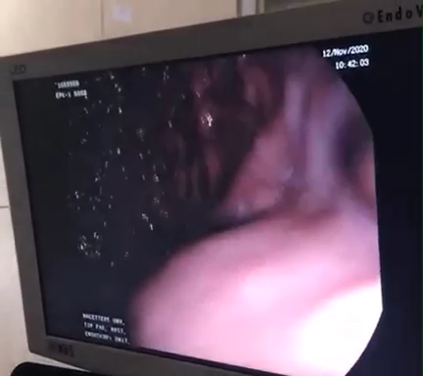
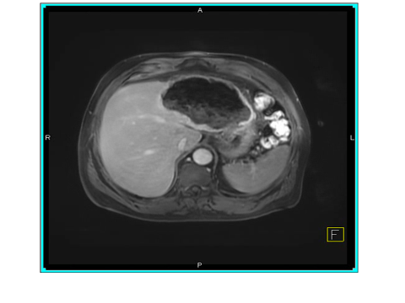

Slide 30
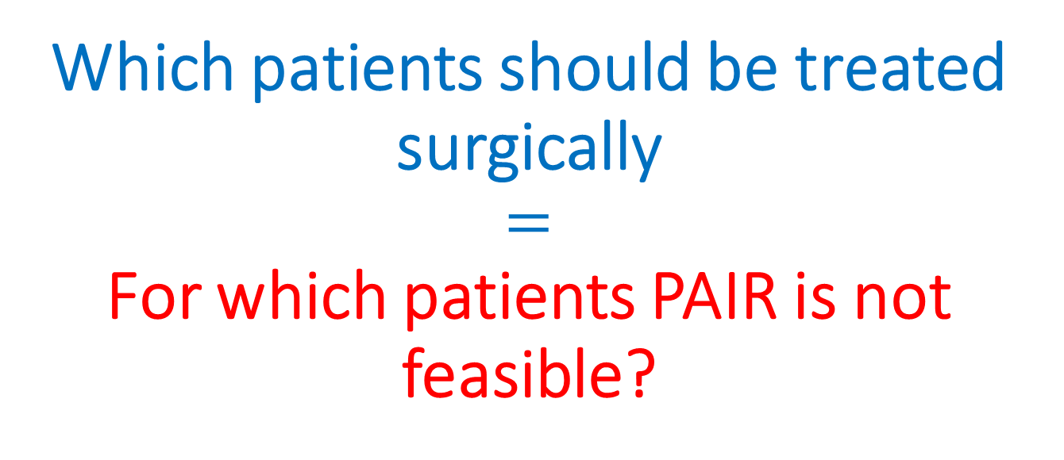
Which patients should be treated surgically
$$=$$
For which patients PAIR is not feasible?
Percutaneously inaccessible cysts
Superficial cysts due to risk of spillage
Cyst communicating with biliary structures (centrally located cysts)?
Complex multiseptated cysts
Nondrainable cysts (CE2 and CE3b)
Ruptured cysts

Slide 31
The treatment of the hydatid cyst remains the attribute of general surgery,
Surgical techniques remains mainstay of treatment for some complicated cases
Surgeons provide therapeutic assistance to clinicians who are dealing with these patients.
Further studies are needed to evaluate the results of percutaneous aproaches for patients with biliary fistula.

Slide 32
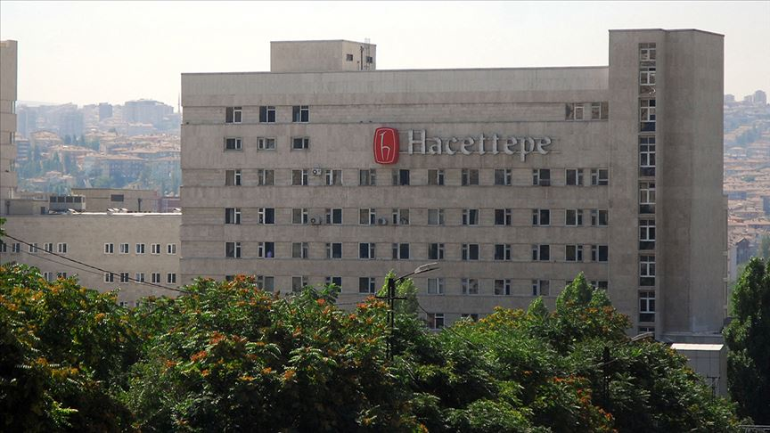
THANKS FOR YOUR ATTENTION

